Slide 1
Predicting Popularity of YouTube Videos
Fariha Baloch
Springboard - Data Science Track

Slide 2
Problem Statement
The purpose of this project is two folds:
Find the most viewed genre of YouTube videos in an economically challenged country like Mexico and an economically stable country like the USA? By focusing on this data YouTube can advertise to the audience of these countries with the videos that can potentially get them more followers/subscribers and in turn more ad revenue
Predict popularity class of YouTube videos and use the information to push popular content to new markets and engage more audiences.

Slide 3
Data Mining
Kaggle has an enormous amount of data on YouTube’s Video Statistics. It can be found at Trending YouTube Video Statistics
The data includes 16 columns (fields) in its raw form for both the USA and Mexico. There are a total of 40,949 records found in the USA csv file and 40,451 records found in Mexico csv files. The data for the most part is clean

Slide 4
Data Wrangling
Columns that were not relevant to this analysis were dropped, e.g.
‘Video_id ,thumbnail_link, description, tags, channel_title
The data doesn’t contain category(genre) by name. A json file, available here, was downloaded and used to map category names to category id
Dropped the rows with NaN and date columns were formatted to DateTime object
Mexico data frame was appended to the USA data frame. Reset_index was performed. All the rows that were duplicates were dropped from the data.

Slide 5
Exploratory Analysis
To see the video viewing trend in both countries, several graphical analysis were performed
Some of the questions asked were
How many unique videos were in each category and how many average views each one received?
For each category how were the average views different from 2017 and 2018?
Which categories showed prominent changes in 2018 compared to 2017?
Were there any correlations between video’s views, likes, dislikes and comment count?

Slide 6
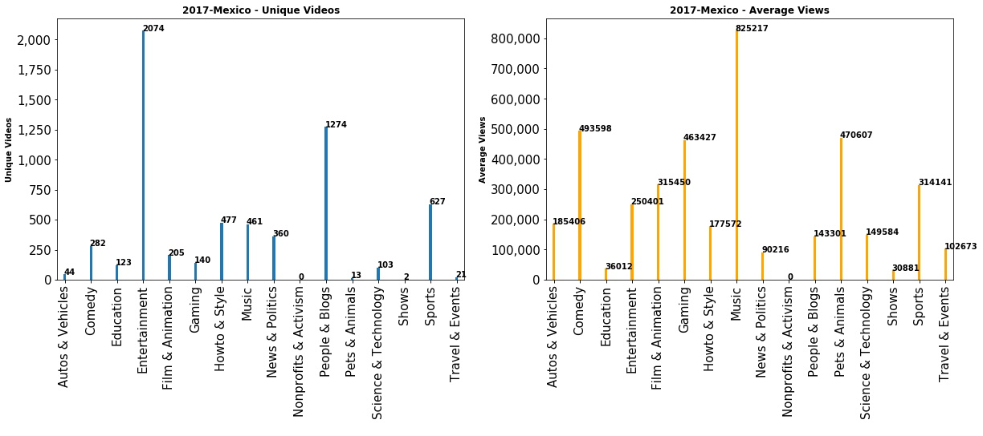
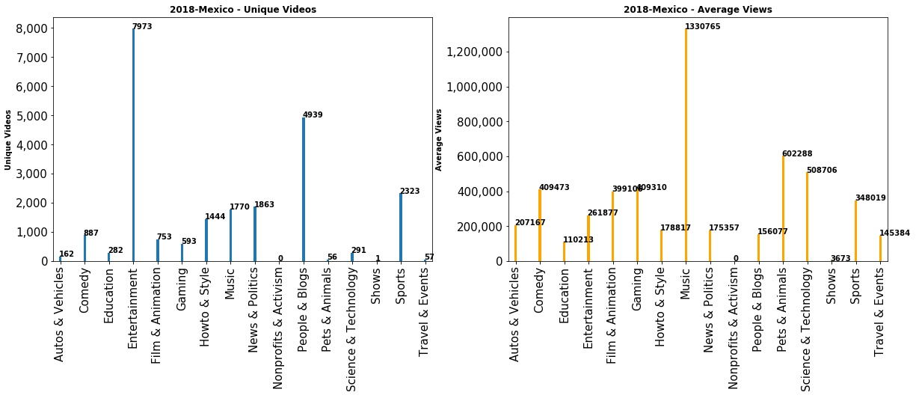
Mexico -
Unique Videos vs Average
Views, 2017 - 2018
Ratios:
2017:
Entertainment: 121 av views/video
Music: 1790 av views/video
2018:
Entertainment: 32 av views/video
Music: 751 av views/video

Slide 7
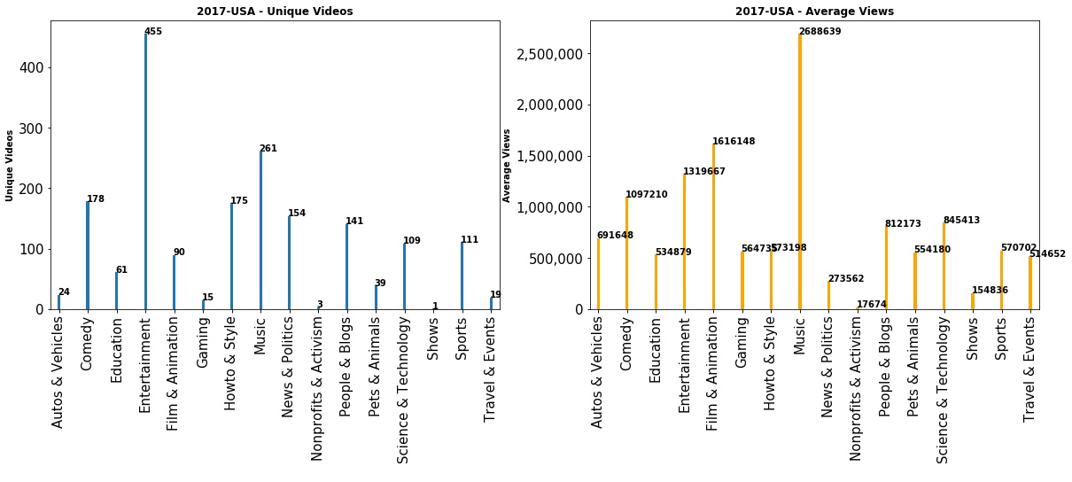
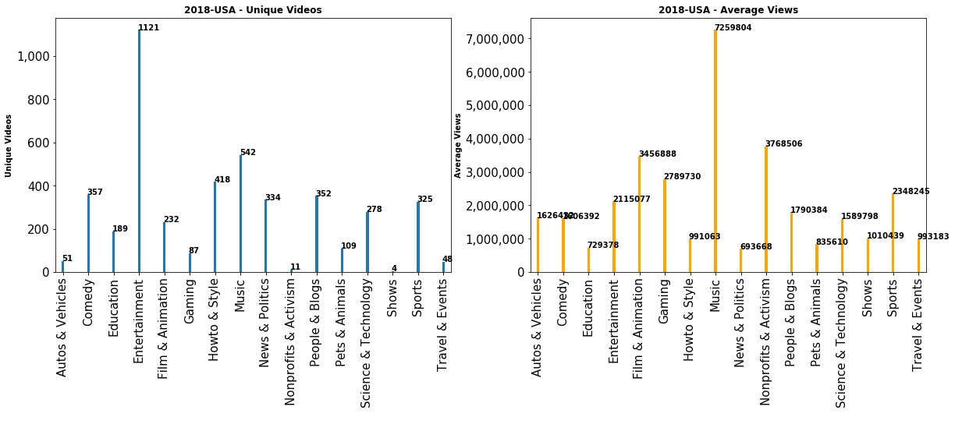
USA -
Unique Videos vs Average
Views, 2017 - 2018
Ratios:
2017:
Entertainment: 2900 av views/video
Music: 10,301 av views/video
2018:
Entertainment: 1886 av views/video
Music: 13,394 av views/video

Slide 8
Unique Videos vs Average Views - Analysis
Mexican audience prefers to watch new content (more unique videos per category) than American audience
American audiences watch same videos again and again (more average views per category)
Even though there are more unique videos in Mexico dataframe, the average number of views (overall) is less than the USA
Music category has the most average views every year in both countries
Pets & Animal category seems to be second to the Music in Mexico (average views)
Film & Animation is second in terms of average views in the USA

Slide 9
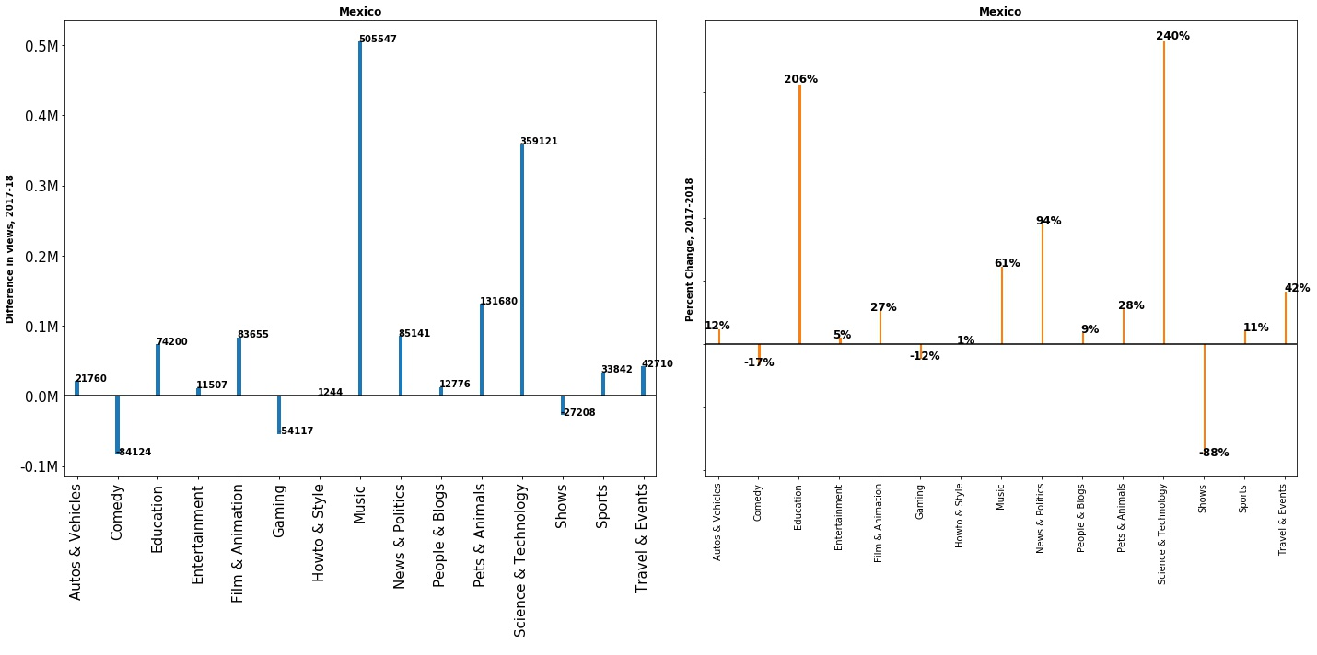
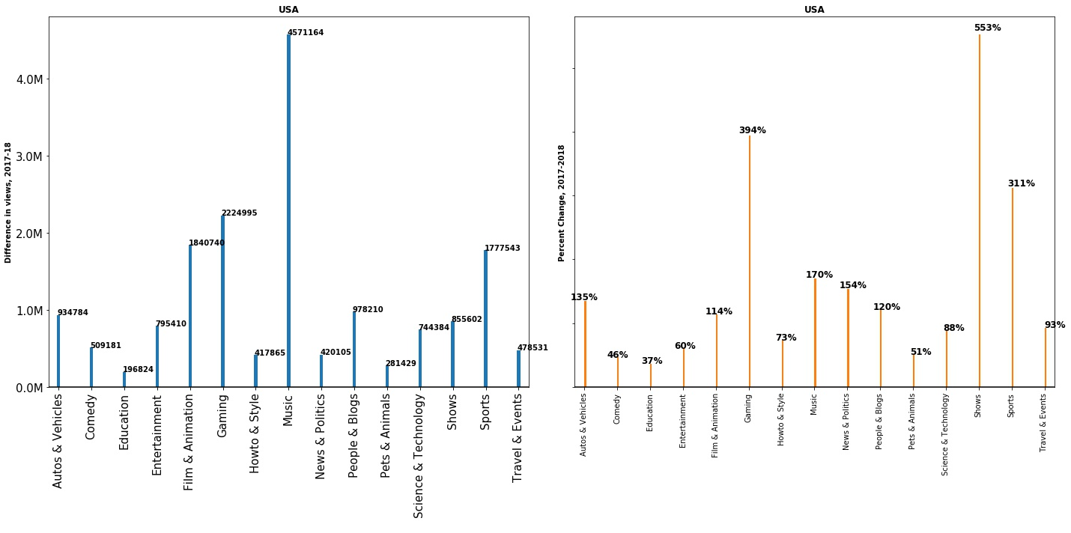
Year to Year Difference in Average Views
2017 - 2018

Slide 10
Year to Year Difference in Average Views - Analysis
The Shows category dominated over other categories in the USA and brought in 553% more average views in 2018
In contrast, views from Mexico for the Shows category dropped 88% in 2018
Mexico viewers watched more of the Science & Technology category videos that gained 240% more average views in 2018
Gaming and the Comedy categories also dropped average views from 2017 to 2018 in Mexico
None of the categories dropped below zero in the number of average views in the USA. However large the change, it was still positive.

Slide 11
Statistical Analysis
Scenario 1: For YouTube to consider investing properly in people, infrastructure etc, they need to know the audience engagement with the videos in both countries. For this they need to know the views distribution and a 95% confidence interval around the population mean
Scenario 2: Does the number of videos in each category depend upon the country it is viewed in? or country has no effect on the video categories and the number of videos in each category?
Scenario 3: How does the expected value of the video views change as time progresses?YouTube could be interested in this data to see how and when to place advertisements and attract traffic to click on a new ad. More interestingly how does the expected value of the difference in the views progress?

Slide 12
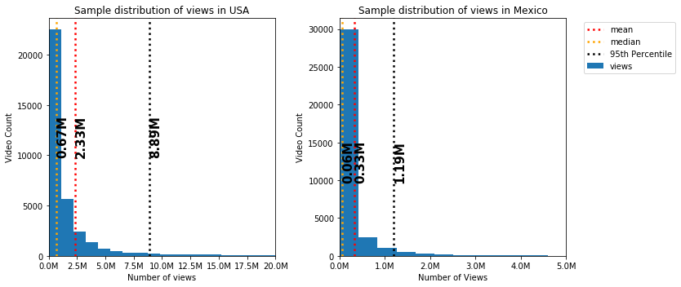
Scenario 1(a):
Mean, Std, and median for the sample data are shown below
SUMMARY OF STATISTICS:
_______________________________________________
USA SAMPLE STATISTICS - VIEWS
________________________________________________
95% of the views are under: 8.89M
Other statistics of the views in the USA:
Sample Mean= 2.33M
Sample Standard Error = 7.26M
Sample Median= 0.67M
________________________________________________
Mexico SAMPLE STATISTICS - VIEWS
________________________________________________
95% of the views are under: 1.19M
Other statistics of the views in the Mexico:
Sample Mean= 0.33M
Sample Standard Error = 1.45M
Sample Median= 0.06M

Slide 13
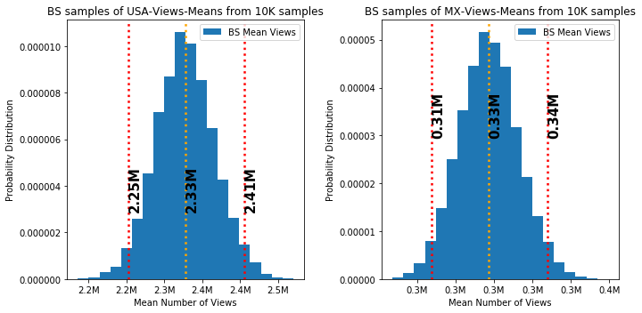
Scenario 1(b):
Inferring population mean using bootstrap method with 10,000 bootstrap samples
USA:Confidence interval (95%) for
population mean is [2.25M ,2.41M]
Mexico:Confidence interval (95%) for
population mean is [0.31M ,0.34M]

Slide 14
Scenario 2:
To determine if the number of videos in each category depend upon the country it is views in, Pearson chi-squared statistical hypothesis test was performed.
H0: The country and category variables are independent
Ha: Two variables are dependent on each other
Results:
Probability=0.95, Critical=25.00, Stat=7532.27
Stat is greater than critical value therefore variables are Dependent (reject H0)
Significance=0.05, p=0.00
P-value is less than alpha (significance level) therefore variables are Dependent (reject H0)
Analysis of Scenario 2:
Since results show that stat returned from the chi2-test is greater than the critical value, the two variables are dependent. Also the p-value returned from the chi2- test is less than alpha showing that the two variables are dependent

Slide 15
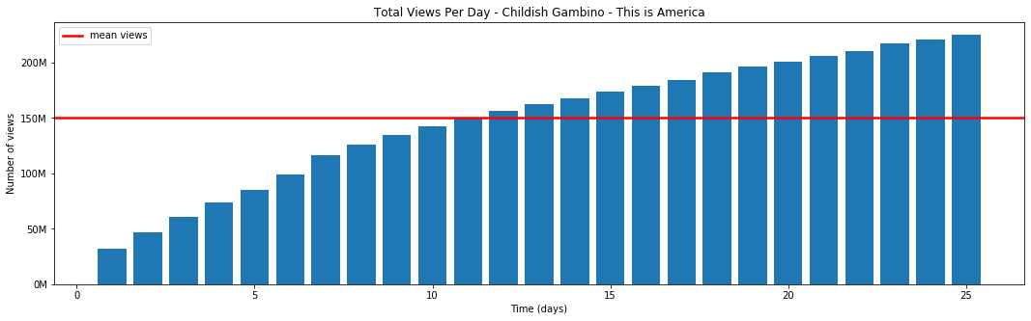
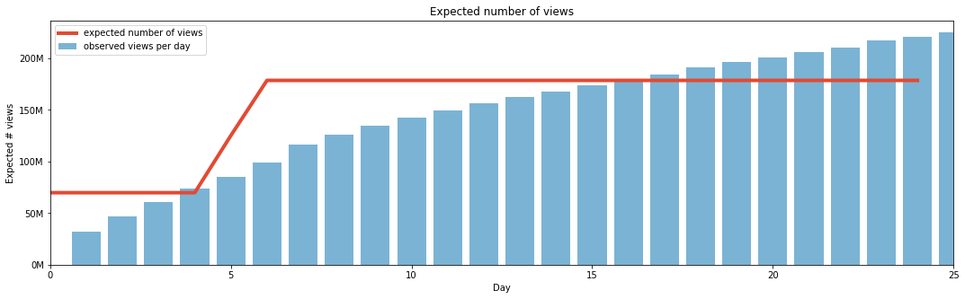
Scenario 3(a)
Bayesian inference was used to find expected value of song “Childish Gambino - This is America” (most viewed song in the USA.
Views per Day
Expected number of views per day using Bayesian Inference

Slide 16
Analysis of Scenario 3(a)
A bar plots in previous slide is to visualize the increment in number of views as the days progress
The data for “Child Gambino - This is America” music video was collected for 25 days. It can be observed that the mean of the views for this video is 150M
The Bayesian model showed a slightly different picture of the same data. Mean value or the expected value of the views derived by using Bayesian method shows that the change in number of views happened between day 5 and 6. Expected value of views went from 75M to 180M views

Slide 17
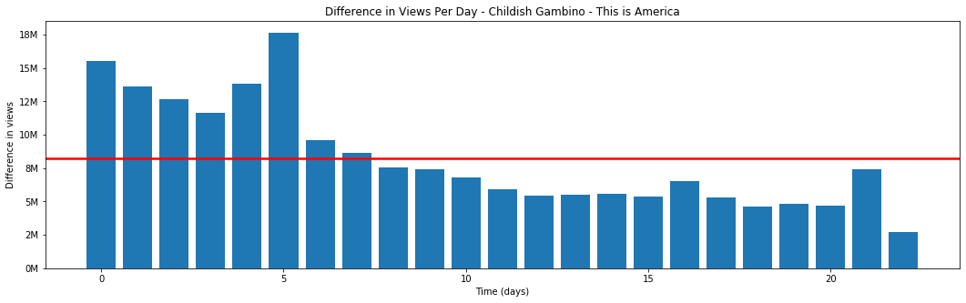
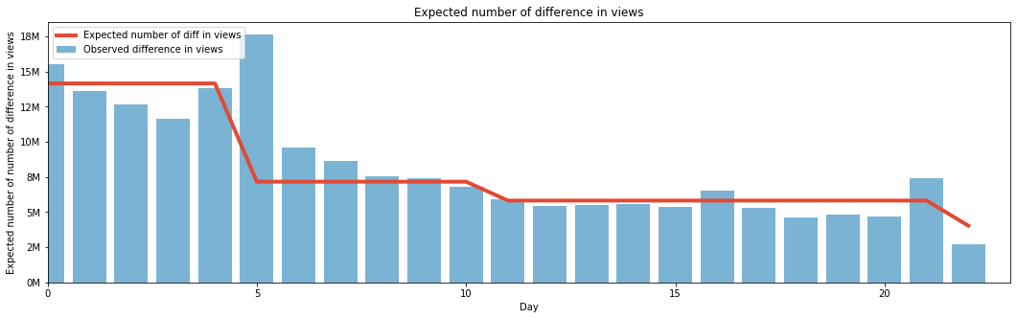
Scenario 3(b):
Bayesian inference was used to find expected value of difference in views of song “Childish Gambino - This is America” (most viewed song in the USA)
Difference in Views per Day
Expected number of difference in views per day using Bayesian Inference

Slide 18
Analysis of Scenario 3(b)
A bar plots in previous slide are to visualize the progress in number of differences in views as the days progress
The difference in Views per day from the sample data clearly shows that between day 5 / 6 a spike in difference occurred which was predicted by model of expected number of views. The mean of the difference in views is 8.2M
The Bayesian model for the expected value of differences in the views show that there are three dips in the difference of views at three different points. Day 5. 10, 21
As any popular video eventually starts declining in viewership as time passes, this model gives a glimpse of when the most views can be achieved and when the decline starts.

Slide 19
Machine Learning
Scenario:
YouTube (the Client) would like to identify which group of videos is popular i.e. which group gets the most views and engagement from the viewers.
YouTube is looking to minimize Type II errors of the prediction model i.e. labeling videos that are popular as not popular should be kept at a minimum

Slide 20
Feature Engineering
A new feature was created to weigh-in each video’s engagement capabilities
Engagement Score (En)= Number of likes + Number of dislikes + 2* Number of comment_count
Additional features added are, title_length, channel_title_length, 10 most common words in the title, publish day, year, date and hour

Slide 21
Clustering
Log of En and Views was used as input to KMeans clustering method to identify classes in the data
Three clusters produced the best boundaries for the classes
The class distribution was imbalanced

Slide 22
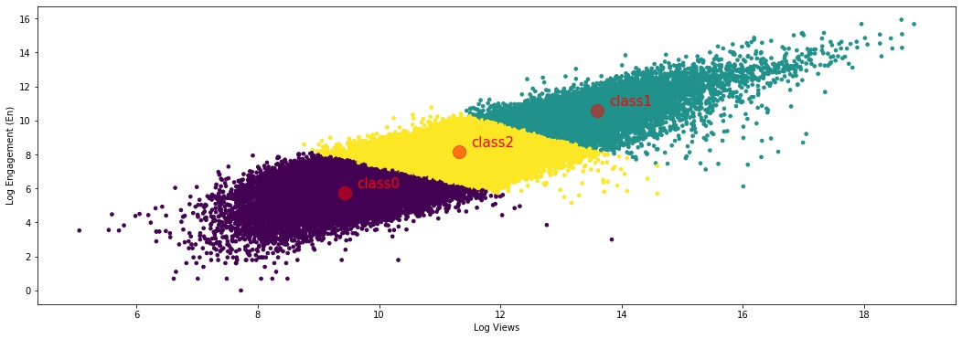
 | Number of Views (e^{x}) | Engagement Score (e^{y}) | Video Count
Class 1 | >=1.2 M | >= 60 K | 9152
Class 2 | 0.2 M <= Views < 1.2 M | 2900 <= En < 60K | 13,851
Class 0 | < 0.2 M | < 2900 | 12,150
Imbalanced Classes - Problematic for classification

Slide 23
Classification
SMOTE (Synthetic Minority Oversampling Technique) was used to balance the imbalanced data
GridSeachCV was used to find best parameters for an estimator
Accuracy Score:
KNN: 58.34
Random Forest: 63.91
Gradient Boost: 54.84
AdaBoost: 52.65
None of the test set accuracy scores are very high
Random Forest is better than others

Slide 24
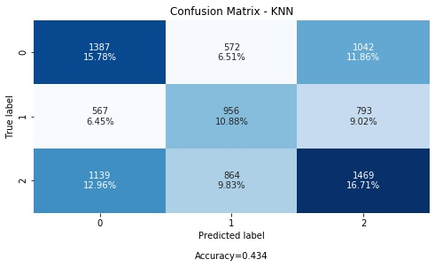
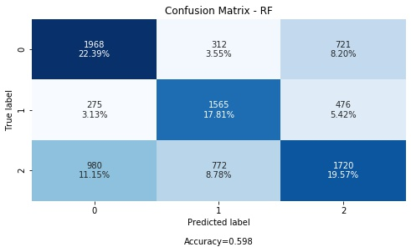

Slide 25
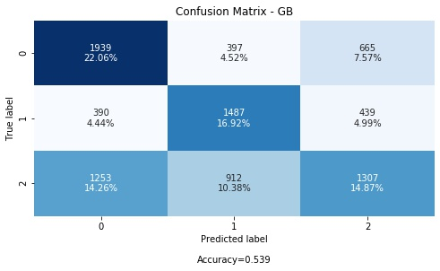
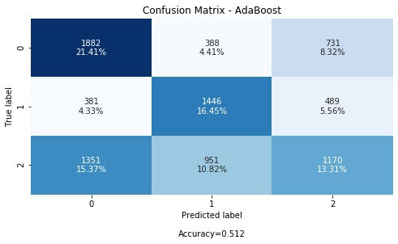

Slide 26
Classification
Precision/Recall/F-Scores – Class-1
 | Precision | Recall | F-Score
KNN | 0.4 | 0.41 | 0.41
Random Forest | 0.59 | 0.68 | 0.63
Gradient Boost | 0.53 | 0.64 | 0.58
AdaBoost | 0.62 | 0.52 | 0.57
Class 1 is most important - more views and more engagement
Type II errors (False Neg) are low → Recall score is high

Slide 27
Conclusion
In both countries, Music was most viewed genre
To predict popularity of a video first the data was clustered and then classification was performed to predict popularity
There were three popularity classes of videos that were produced by K-Means algorithm. Highest views and engagement was by class 1
Since the goal was to classify a new video as class 0, class 1 or class 2 and remote videos tagged as class 1 to audiences as they will bring in more views, several classification methods were applied on the data
Random Forest performed the best, highest accuracy (64%) an highest recall score (68%)
Highest recall means least number of FN (class 1 classified as class 0 or 2)

Slide 28
Future Work
More countries could be added to observe trends in their YouTube video datas
Compare with MX and the USA
Adding user information into the data with their ages and interests could make predictions for each age group a littler better and targeted promotions of videos will bring more relevant views to the videos

